Slide 1
ADJECTIVES
(Juan Gonzalo)

Slide 2
Adjectives
Adjectives are words that describe the qualities or states of being of nouns, for example: enormous, doglike, silly, yellow, fun, fast. They can also describe the quantity of nouns, for example: many, few, millions, eleven.
Adjectives usually come immediately before the nouns they modifie.

Slide 3
Examples:
She is happy
My dog is old
The house is big
My mom is beautiful

Slide 4
Look at the video
https://youtu.be/CZ2cs25EHWc
Opposite Adjectives: Useful List of Opposites of Adjectives in English with Pictures
Luego de ver el video copiar los adjetivos que aparecen al final y escribir un ejemplo de cada uno.

Slide 5
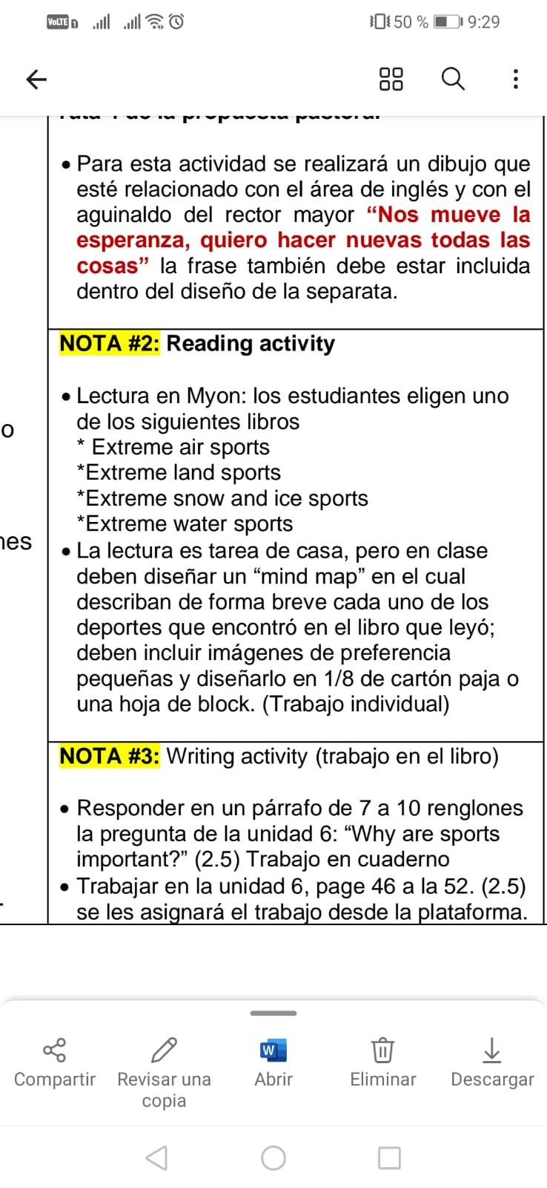

Myon Activity: (Bibiana / Camila)
Traer materiales la próxima clase para hacer el mapa
mental (cartulina, carton paja, imagenes alusivas al libro leído, colores, etc.

Slide 6
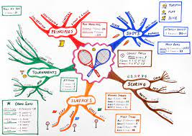
Mind map (Germán/Maritza y Alfredo

